Slide 1
Irritant gases
Rob Hendrickson, MD
Oregon Poison Center

Slide 2
What are irritant gases?
Ammonia
Chlorine
Hydrogen Chloride
Hydrogen sulfide
Phosgene
Exposures are:
  Large releases
  Small releases / exposures
Notes:
Important

Slide 3
Chemical Accidents in U.S. Industry 1994-1999
#1 Anhydrous Ammonia 656
#2 Chlorine 518
#3 Hydrogen Fluoride 101
#4 Flammable Mixture 99
#5 Chlorine Dioxide 55
#6 Propane 54
#7 Sulfur Dioxide 48
#8 Ammonia (>20%) 43
#9 Hydrogen Chloride 32
#19 Phosgene 12
Notes:
Important

Slide 4
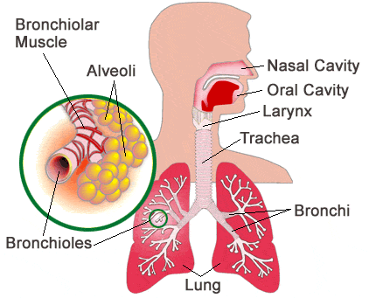
Irritant Gases: general effects
Classified according to water solubility: determines clinical effects
  Highly water-soluble
    mucous membranes of eyes & upper airway
  Intermediately water-soluble
    upper airway & alveoli
  Slightly water-soluble
    alveolar-capillary membrane
    Inadequate warning properties
      Can result in prolonged exposures
    delayed-onset acute lung injury (ALI)
www.medicinenet.com

Slide 5

Common Irritant Gases
High water solubility
  Hydrochloric acid
  Ammonia
  Hydrogen sulfide
Intermediate water solubility
  Chlorine
Poor water solubility
  Phosgene

Slide 6
Irritant Gases
Combine with water in mucosa/airway to produce caustic/irritant chemical:
  Chlorine: Cl₂ + H₂0 -> HCl + HClO
  Phosgene: COCl₂ + H₂O -> 2HCl + CO₂
  Ammonia: NH₃ + H₂0 -> NH₄OH (ammonium hydroxide)
Notes:
Ammonium hydroxide

Slide 7
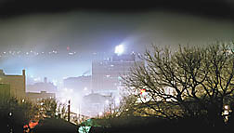
Acute exposures

Slide 8
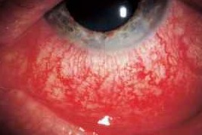
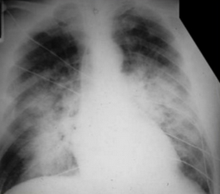
Symptoms - acute
Mucous membrane irritation
Upper airway irritation
Lower airway irritation
www.alpfmedical.info

Slide 9
Treatment - acute
Mucous membrane irritation
  decontamination
Upper airway irritation
  Bronchodilators
  Corticosteroids
Lower airway irritation
  Oxygen
  Non-invasive ventilation
  Intubation, ARDS protocol ventilation

Slide 10
Disposition – acute exposures
High water solubility
  Immediate symptoms
Intermediate water solubility
  Immediate and delayed symptoms
  Observe for worsening lung function
Poor water solubility
  Delayed ALI
    Admit for 24h monitoring

Slide 11
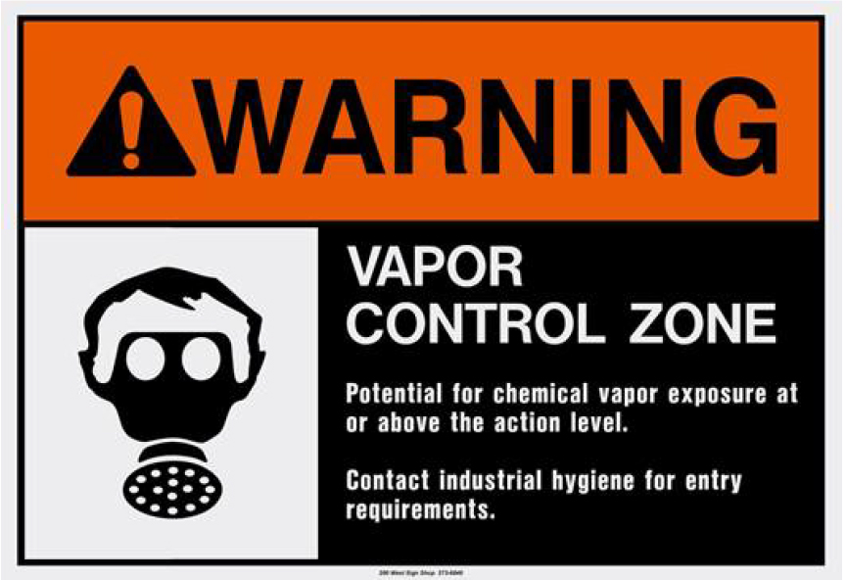
Chronic exposures

Slide 12
Symptoms – prolonged or chronic
RADS
  Airway hyperresponsiveness
  Single exposure
  High dose exposure
Irritant induced asthma
  Airway hyperresponsiveness
  Multiple exposures
  Lower dose exposures

Slide 13
Treatment – prolonged or chronic
RADS
Irritant induced asthma
  Inhaled bronchodilators
  Oral or inhaled corticosteroids
Notes:
Eosinophilic mucosa, mucosal edema.

Slide 14
Mitigation strategies
PPE – respiratory protection
Positioning
Ventilation
Decontamination stations / equipment
Detectors (some irritant gases have poor warning properties)
Notes:
Eosinophilic mucosa, mucosal edema.

Slide 15
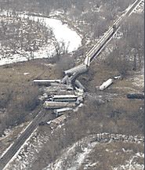
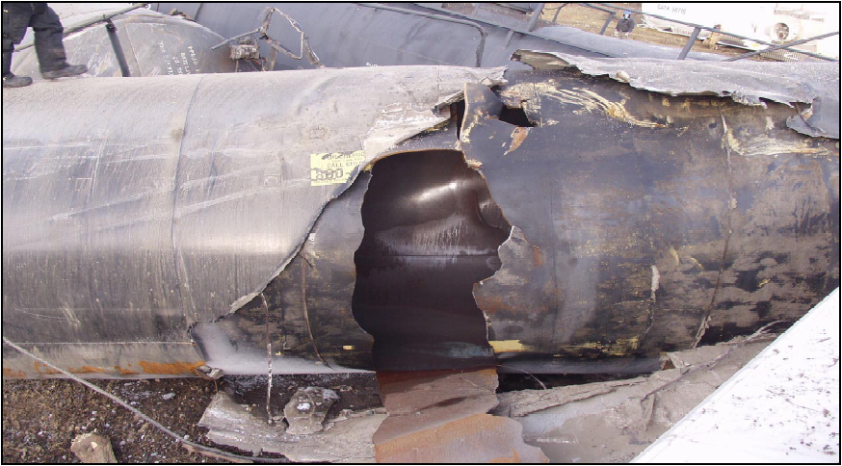
Cases
10 of 31 cars - 250,000 gallons - cloud 5x3miles

Slide 16
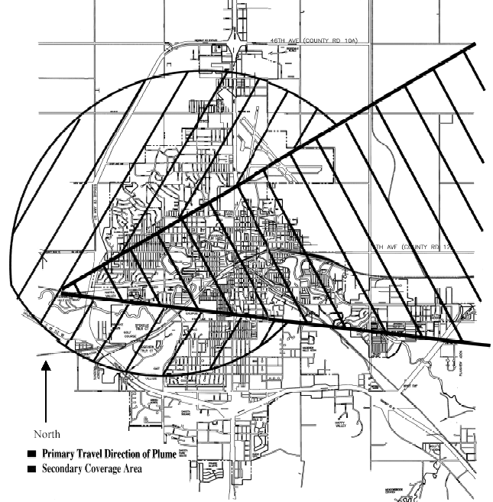
◎

Slide 18
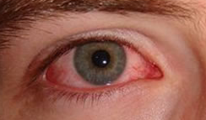
15,000 people affected
300 patients arrive at the local hospital the first night
Thousands have symptoms
  Mucous membrane irritation
Minot, ND

Slide 19
Ammonia
Highly water soluble irritant gas
  Predominantly mucosal irritation
  Minimal lung irritation/ALI
  Treatment:
    Decontamination
      (bronchodilators/corticosteroids for bronchospasm)
Occupational uses:
  Fertilizer; precursor for chemical production (nitric oxide, hydrazine, phenol, urea, etc); cleaner; antimicrobial (beef)
Notes:
88% of the world’s use of ammonia is for fertilizer

Slide 20
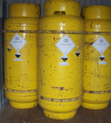
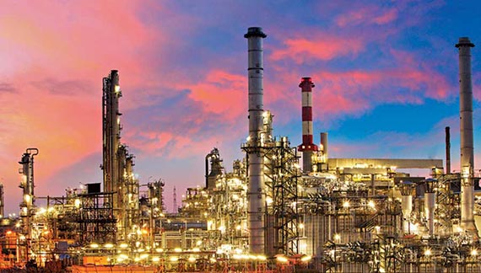
Case
29 M petroleum refinery worker
Spill of ‘neutralizing agent’
Describes a ‘suffocating’ smell
Reports eye/nose/mouth irritation
Cough
No shortness of breath

Slide 21
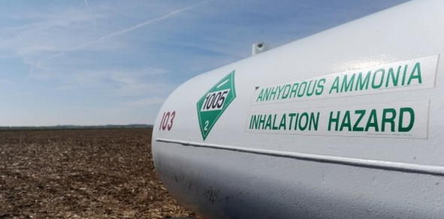
Conjunctival injection
Rhinitis
Pharyngitis
Cough
Clear breath sounds
No stridor or dysphonia
Ammonia

Slide 22
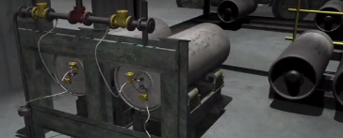
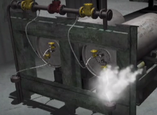
Case
38 yo female worker at chemical manufacturing plant
1 ton compressed gas tanks used to manufacture pesticide ingredients
1 ton cylinders stored in a shed
Gas accessed via flexible braided stainless steel hoses
Worker was inspecting the cylinders when a hose burst

Slide 23
Patient states she was coughing initially
Feels well in the Emergency Department
Reports smell of ‘moldy hay’
Noted a colorless vapor leaking from the hose
The patient would like to be discharged back to work to finish her inspection

Slide 24
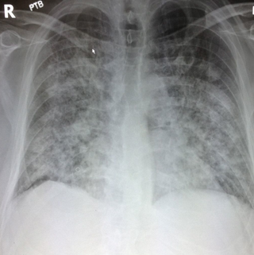
4 hours into ED observation: significant difficulty breathing
Admission: at 18 hours post-exposure, patient requires intubation in the ICU
ALI

Slide 25
Phosgene
Low water solubility irritant gas
  Minimal mucosal symptoms
  Delayed onset ALI
  Treatment:
    Oxygen
    BiPap / intubation (ventilation)
    Bronchodilators
    Corticosteroids
Occupational uses:
  Chemical synthesis (carbonates, isocyanates)
Notes:
Phosgene: polyurethane production, dye/resin/pesticide production,

Slide 26
Case
Several swimmers at an indoor pool note pungent odor of “bleach”
Mildly irritating to eyes
Over hours, swimmers develop
  Cough
  Shortness of breath
  Chest tightness
  Throat pain

Slide 27
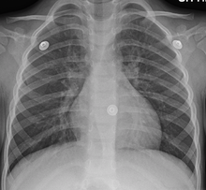
Diffuse wheezing
Coughing
Chest tightness
Chest xray:
  peribronchial cuffing
  hilar thickening

Slide 28
Chlorine
Intermediate water soluble irritant gas
  Mild mucosal irritation
  Predominant bronchospasm
  Possible ALI
Treatment:
  Bronchodilators
  Corticosteroids
Occupational uses:
  Chemical manufacture (vinyl chloride, polyvinyl chloride, 1,2-dichloroethane, etc), disinfectant products

Slide 29
Irritant gases
Toxicity depends on water solubility
Symptoms may be delayed with low water soluble gases
Treatment is mostly symptomatic
Patients with a single, large exposure are at risk for RADS
Patients with chronic exposures may be at risk of irritant-induced asthma

Slide 30
Additional occupational irritants
Isocyanates – plastics, rubber, polyurethane foam manufacture;
Hydrogen sulfide – petroleum industry
Ozone – pulp mills, paper manufacture, bleaching
Sulfur dioxide – smelting, sulfuric acid production
Nitrogen dioxide – nitric acid production, chemical explosives

Slide 31

Questions???

